Slide 1
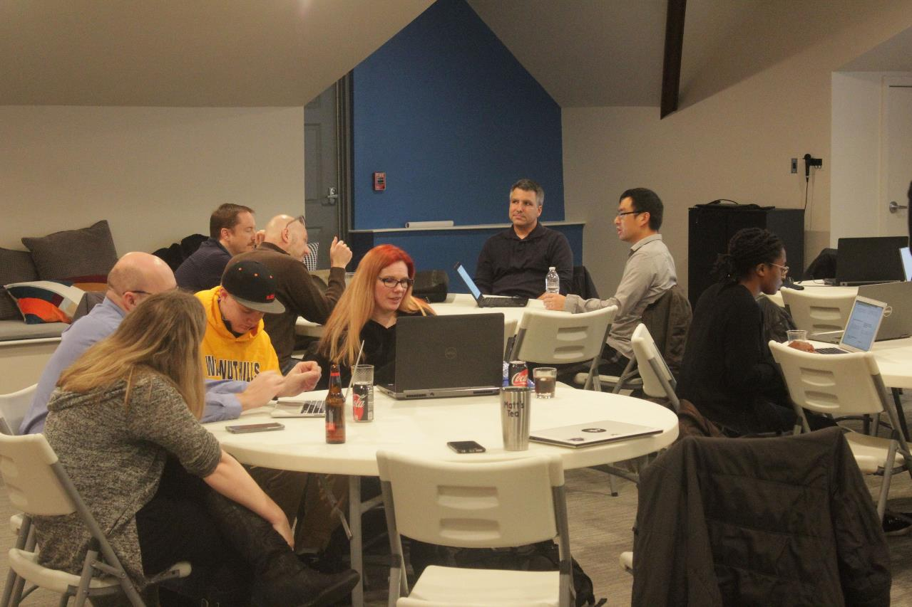
Code, Craft, Community
9/20/2023

Slide 2


Slide 3
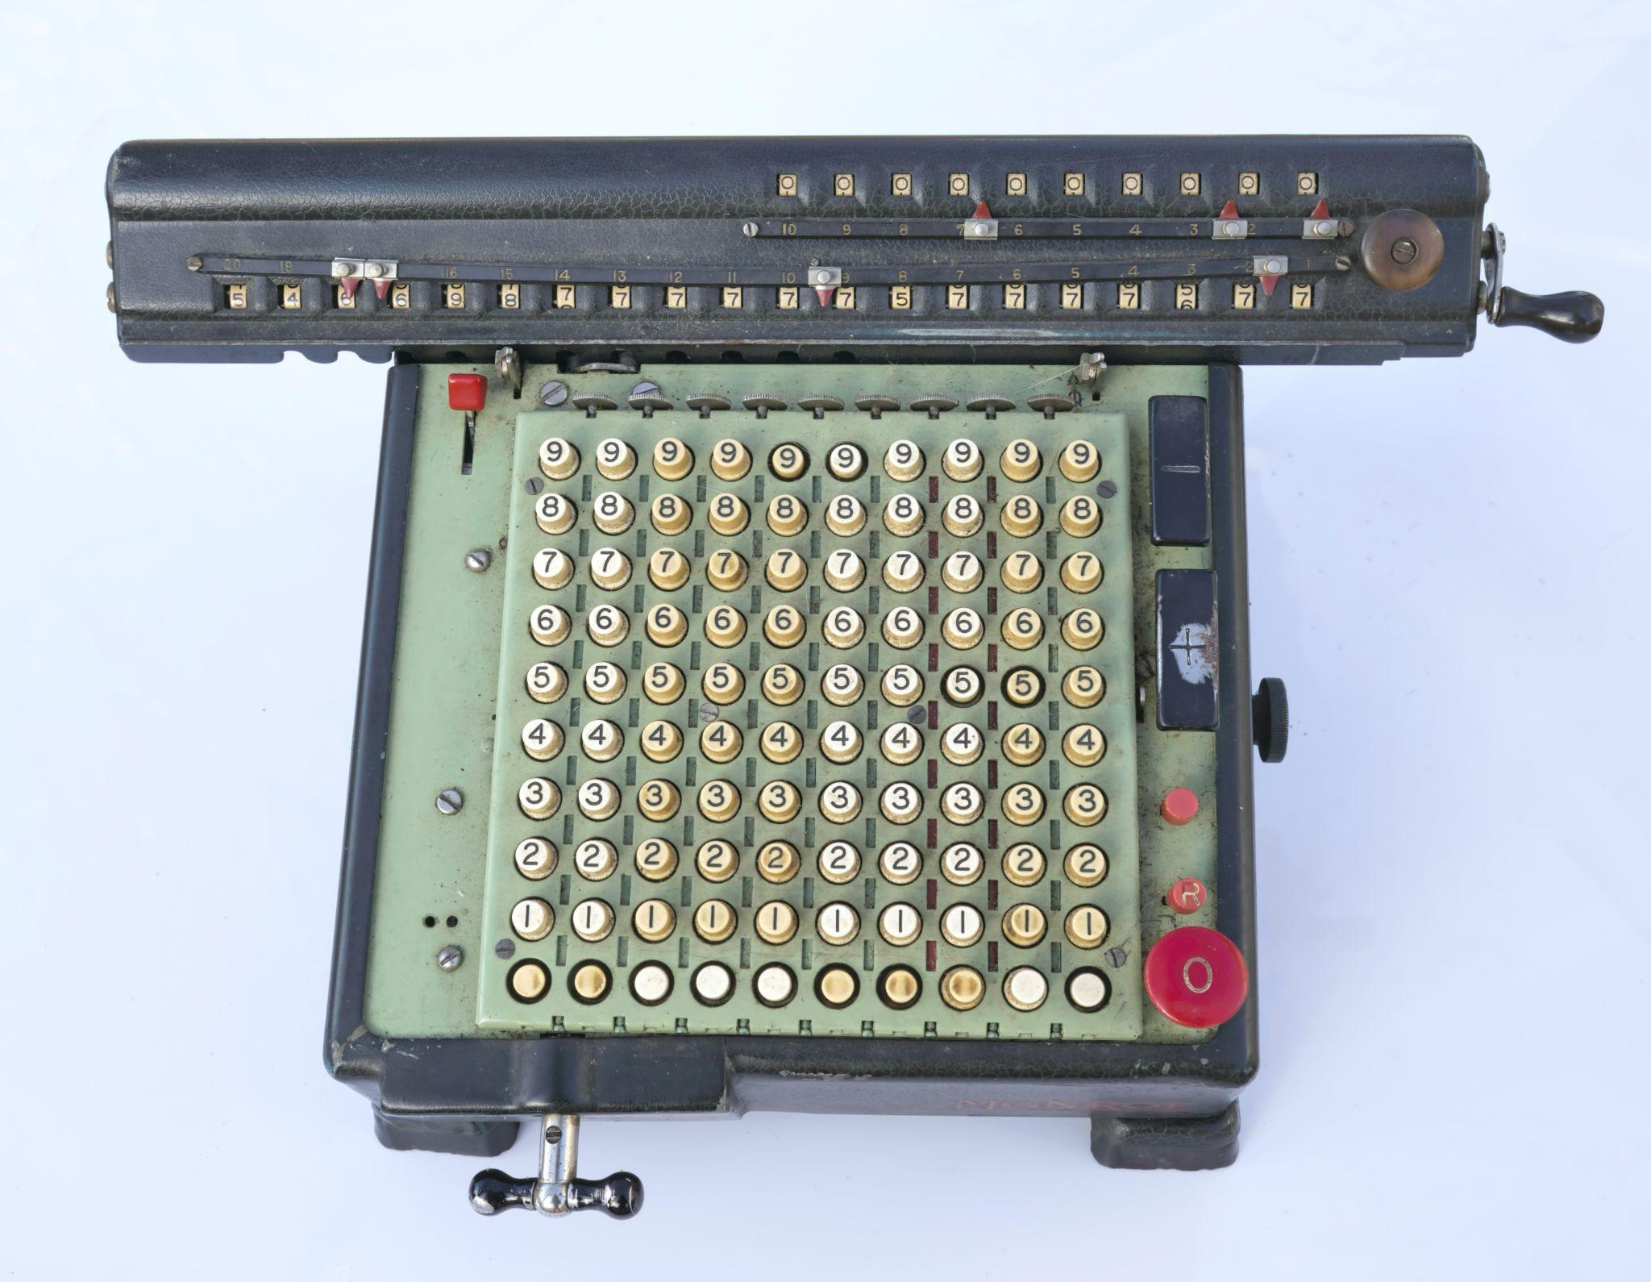
Photo by Loren Biser on Unsplash

Slide 4
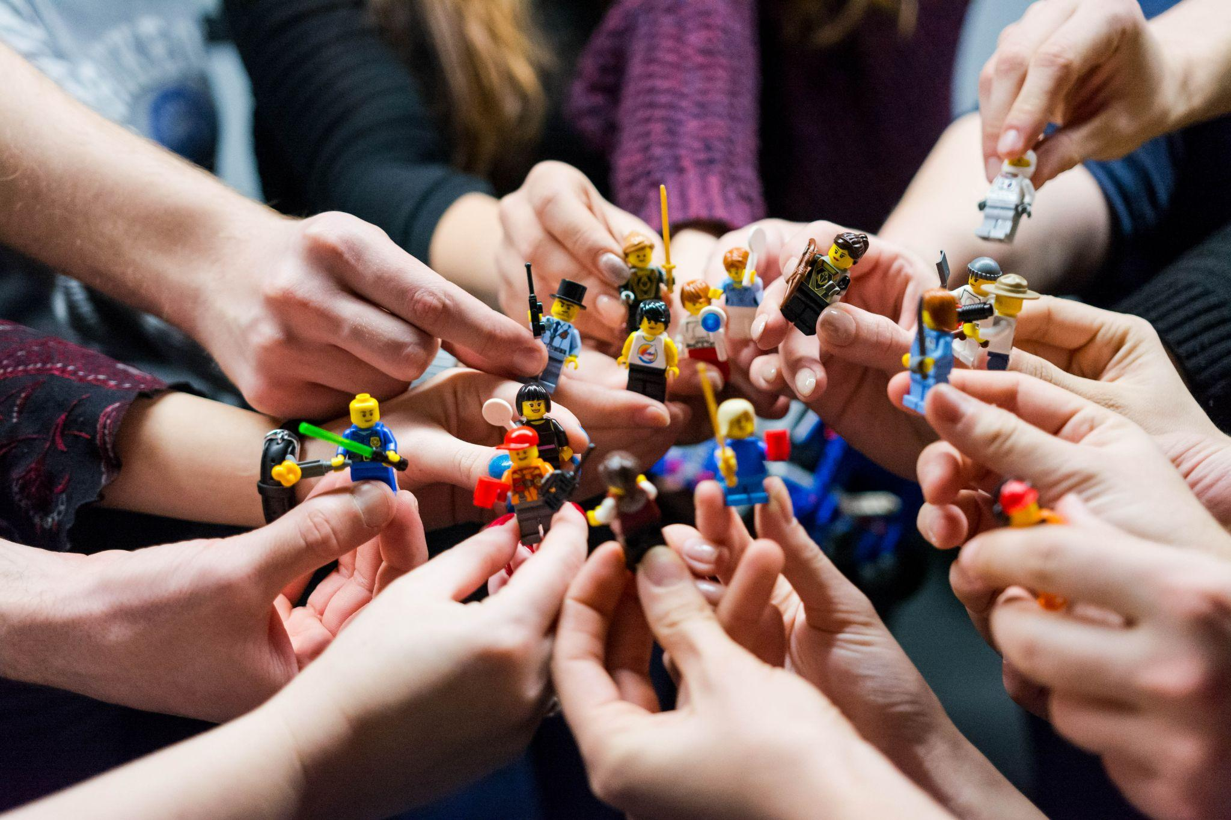
Photo by Vlad Hilitanu on Unsplash

Slide 5
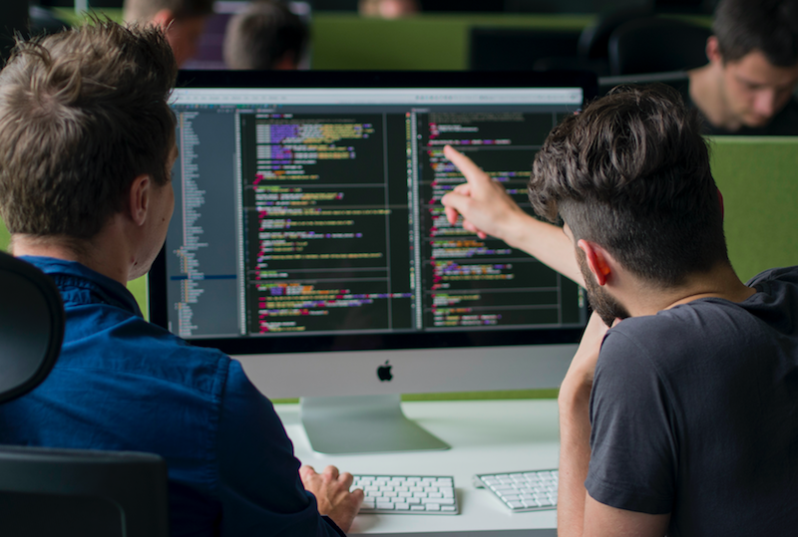

Slide 6


Photo by Mimi Thian on Unsplash

Slide 7
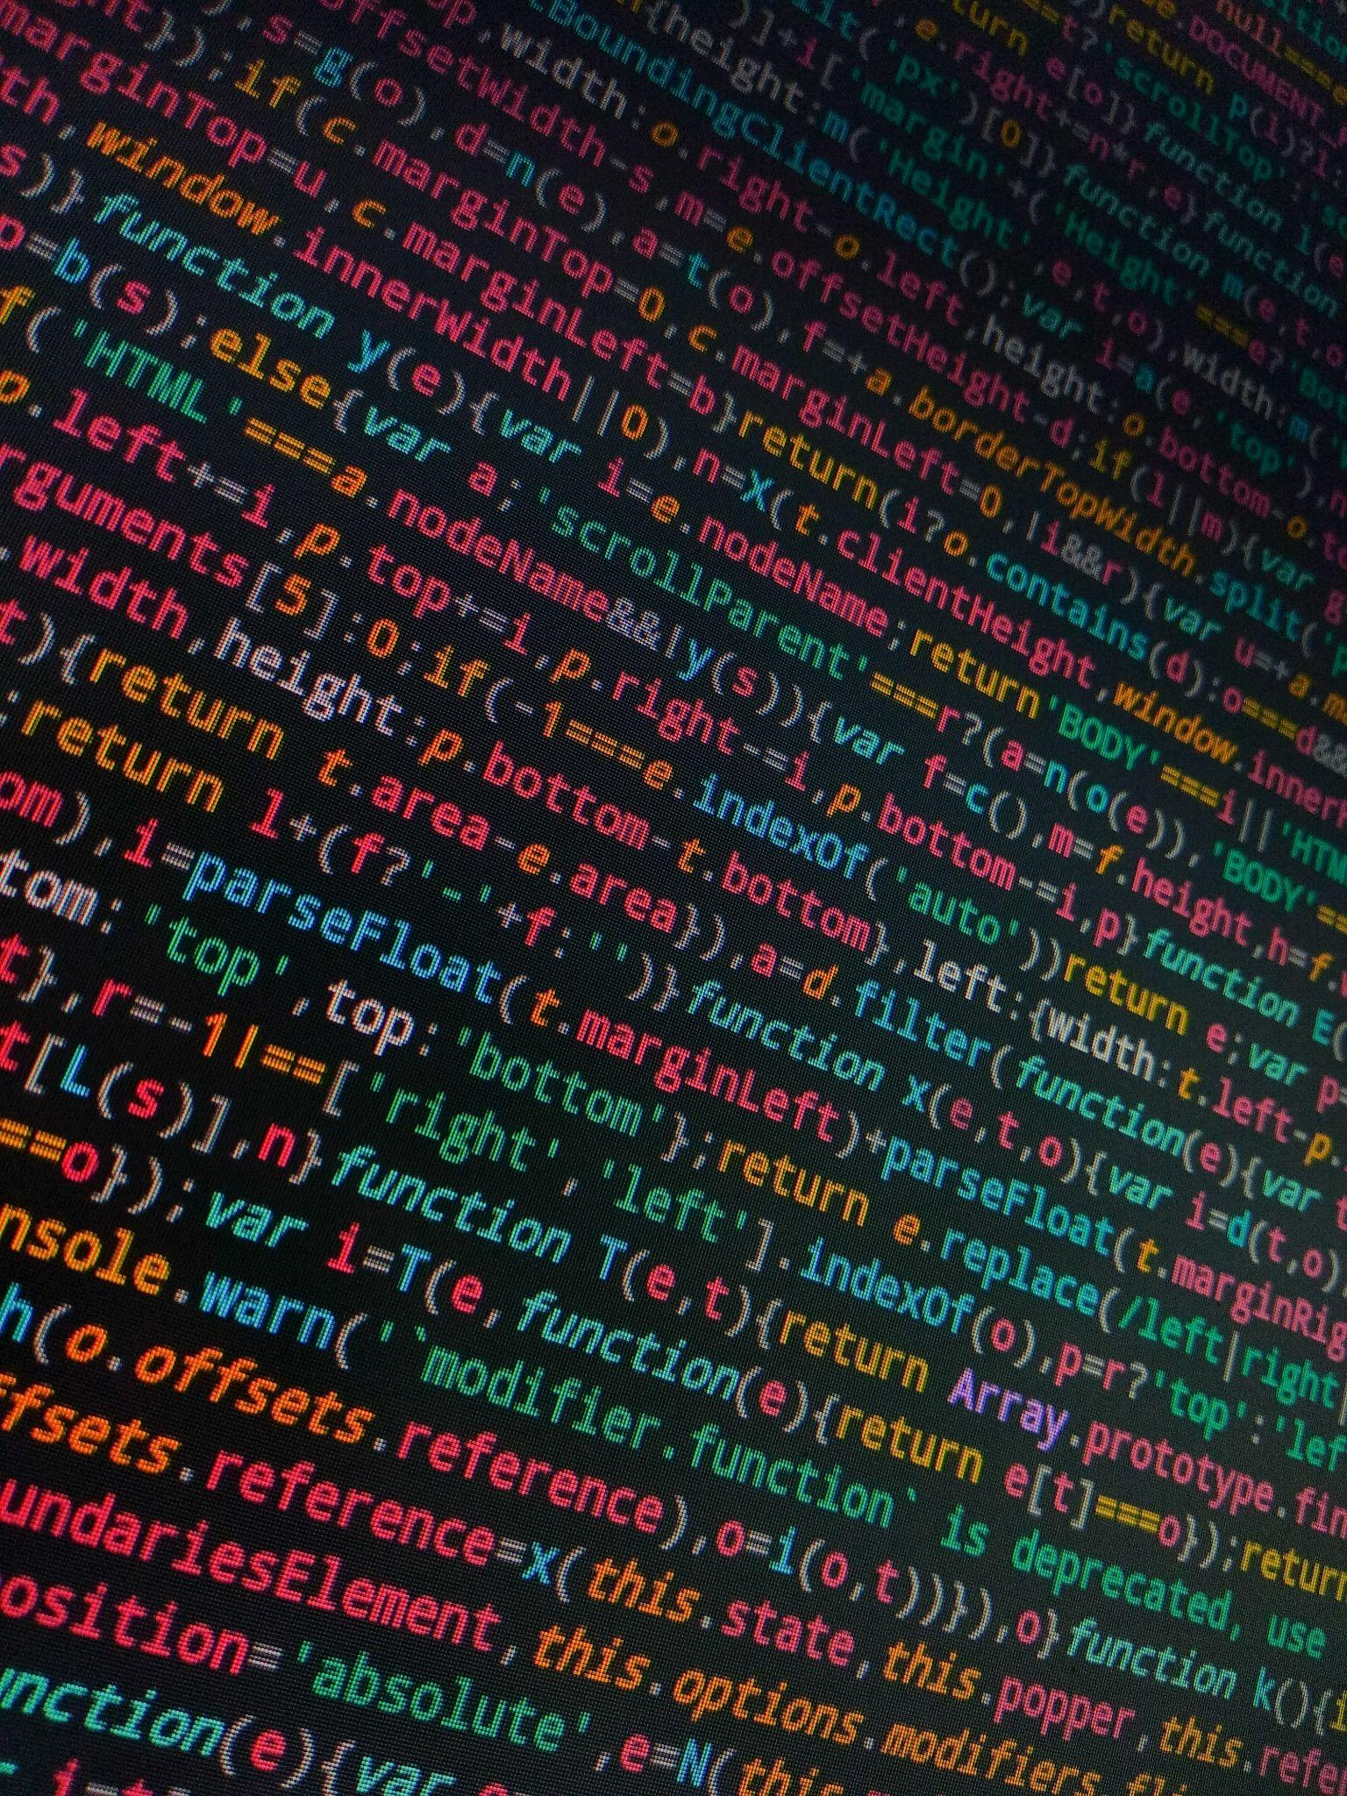
Photo by Walkator on Unsplash

Slide 8

Photo by Alan Hardman on Unsplash

Slide 9
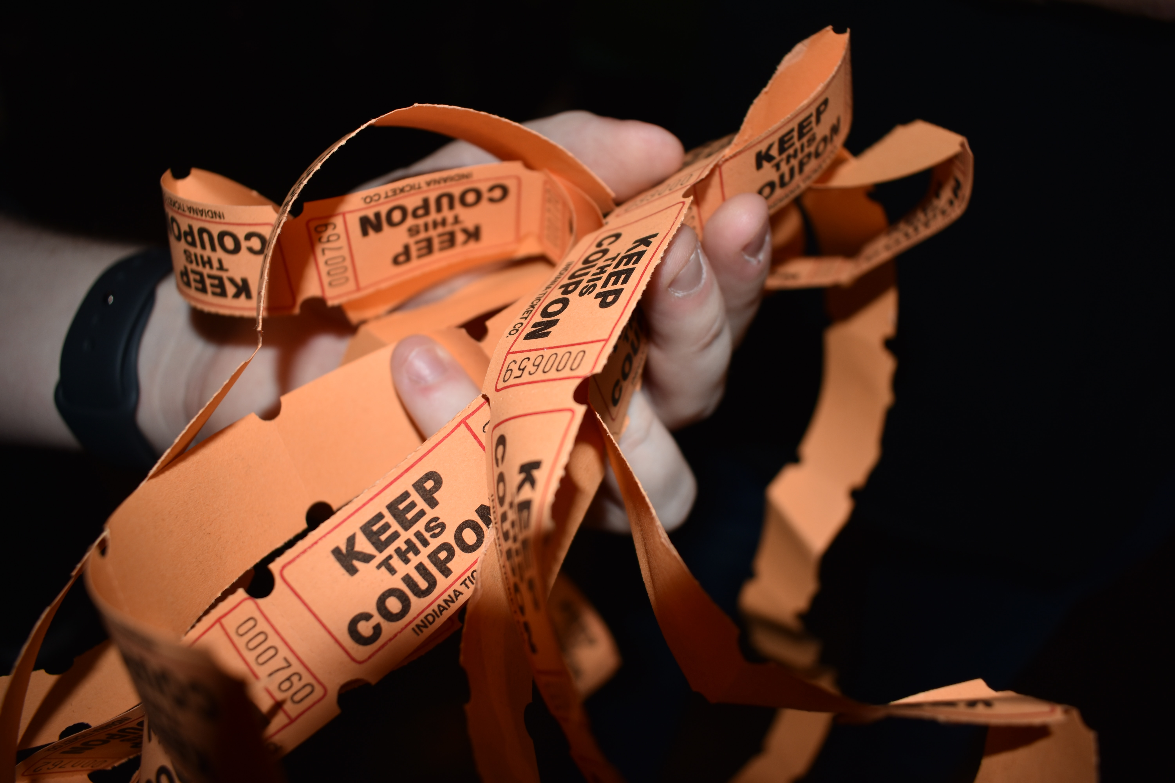
Photo by Julia Morales on Unsplash

Slide 10

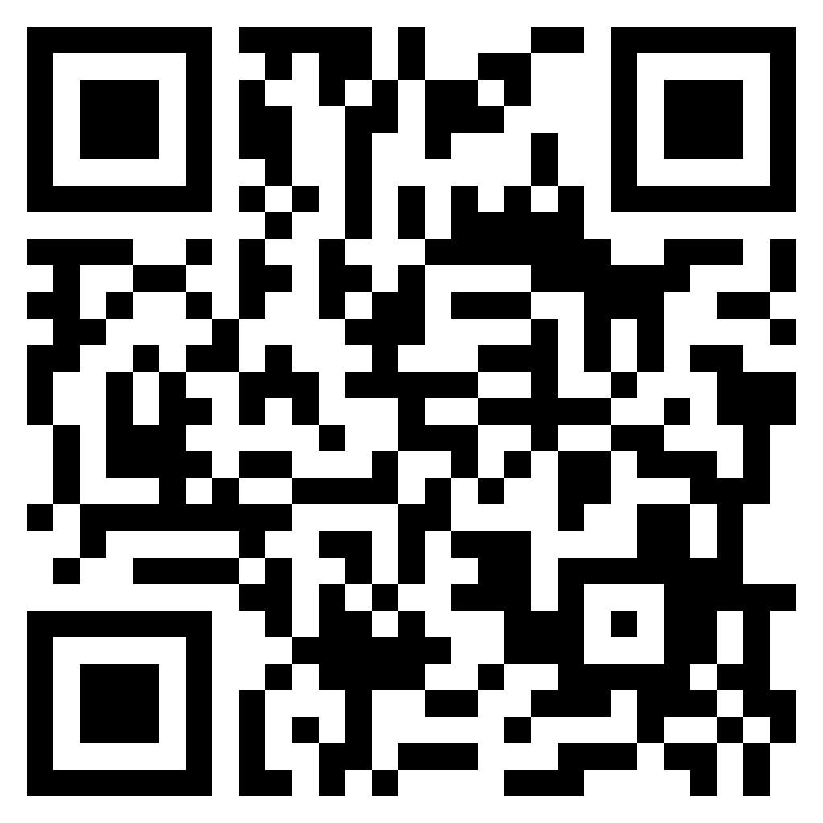
<///> Momentum Developer Conference
https://momentumdevcon.com/
Use QR Code For $10 Discount
https://ti.to/the-circuit/momentum-2023/discount/c3

Slide 11
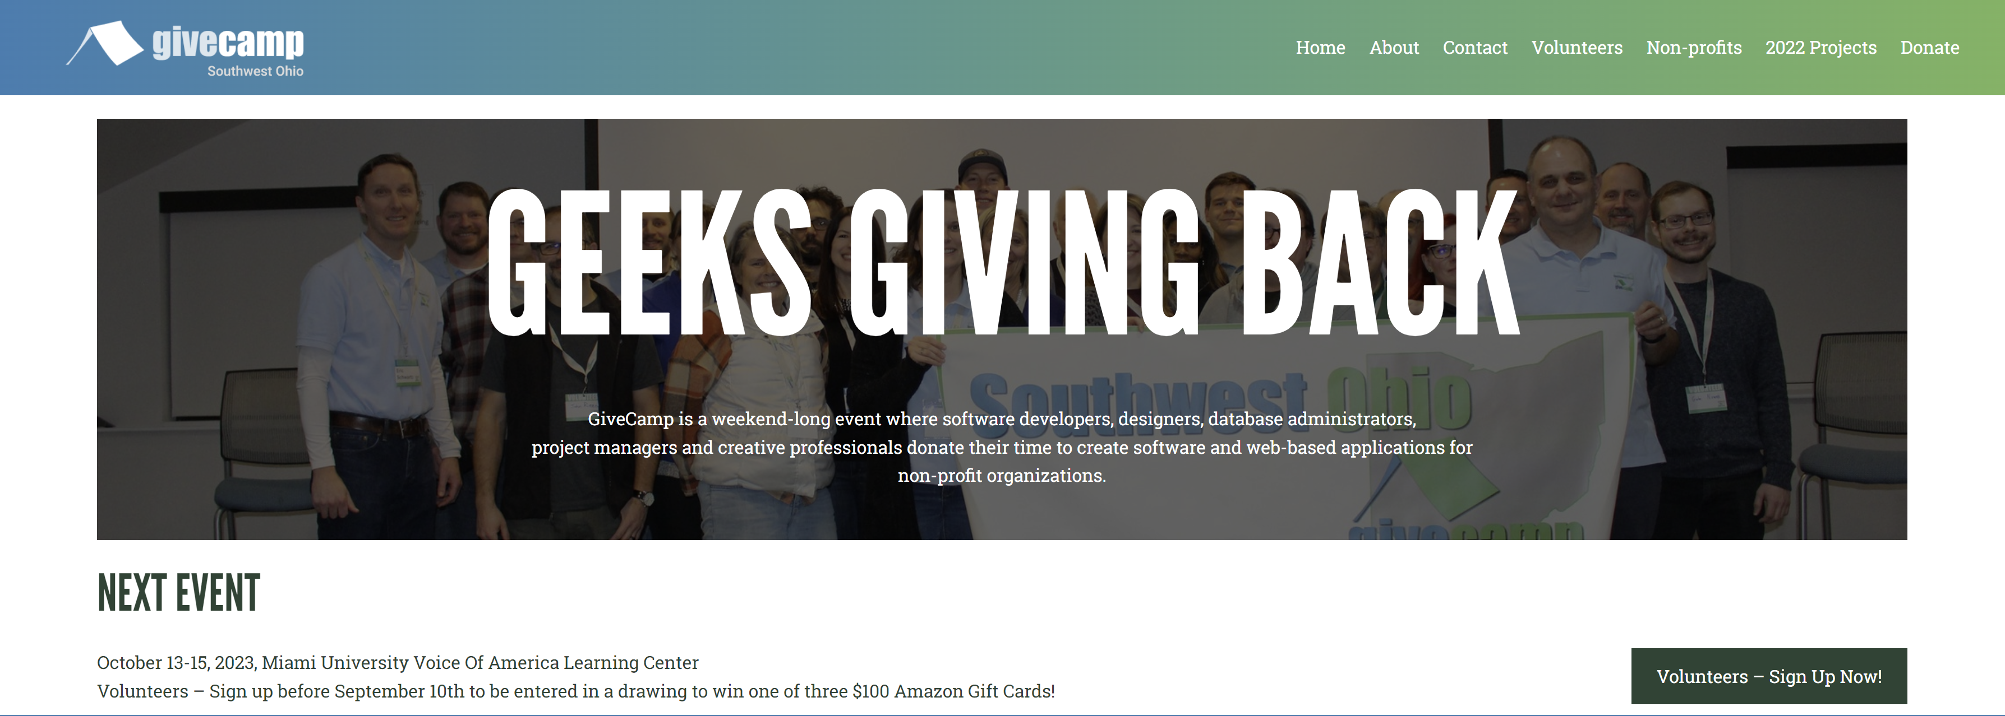
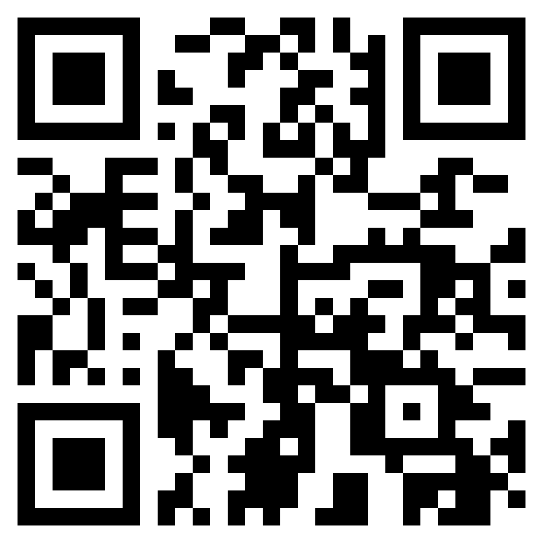
Southwest Ohio GiveCamp
https://southwestohiogivecamp.org/

Slide 12
Agenda
Intro
Functional Programming
Map
Reduce
Filter
LINQ (C#)
Streams (Java)
Pair up & code
Retro
Raffle Giveaway

Slide 13
Functional Programming
“Functional programming is like describing your problem to a friend, rather than giving precise instructions to a computer.”
- John M. Hughes

Slide 14
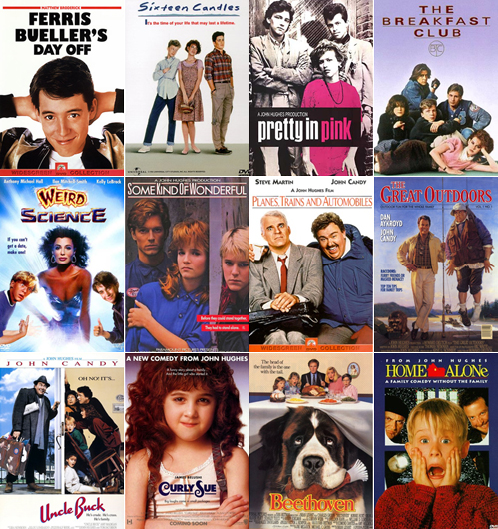
Not THAT John Hughes…

Slide 15
Functional Programming Principles
Tonight’s exercise revolves around a few specific Functional Programming operators, but to understand those, a quick intro to Functional Programming is needed.
At a 10,000 foot level, Functional Programming languages rely on Pure Functions to perform operations without mutating data or using flow controls (conditionals, loops, etc).
Pure Function
Stateless
Immutable data

Slide 16
FP Principles: Pure Functions
Pure Functions
Return the same output for a given set of inputs
Do not change any state (inputs, or otherwise)
No side effects!
// Pure
function sum(n1: number, n2: number): number {
return n1 + n2
}
// Not Pure
let total: number
function sum(n1: number, n2: number): number {
total = n1 + n2 // Side effect – modifying total
return total
}

Slide 17

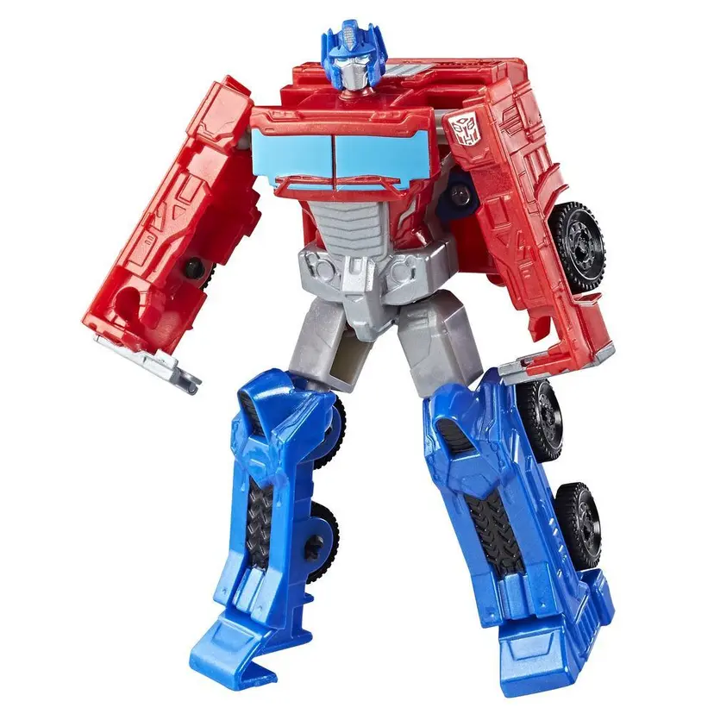
Map
Operate on the elements in a collection
Often used to convert or transform the elements

Slide 18

Map – The Imperative Way
const words = ["CODE", "CRAFT", "COMMUNITY"]
for (let i = 0; i < words.length; i++) {
words[i] = words[i].toLowerCase()
}
console.log(words)
// Output is: ["code", "craft", "community"]

Slide 19
Map – The Imperative Way
A little better…
const words = ["CODE", "CRAFT", "COMMUNITY"]
const wordsLower = []
for (let word in words) {
wordsLower.push(word.toLowerCase())
}
console.log(words)
// Output is: ["CODE", "CRAFT", "COMMUNITY"]
console.log(wordsLower)
// Output is: ["code", "craft", "community"]

Slide 20
Map
Map Function
Creates a new collection using entries from the original collection
const words = ["CODE", "CRAFT", "COMMUNITY"]
const wordsLower = words.map(word => word.toLowerCase())
console.log(words)
// Output is: ["CODE", "CRAFT", "COMMUNITY"]
console.log(wordsLower)
// Output is: ["code", "craft", "community"]

Slide 21

Reduce
Operate on the elements in a collection
Return a single (usually…) value resulting from the operations

Slide 22
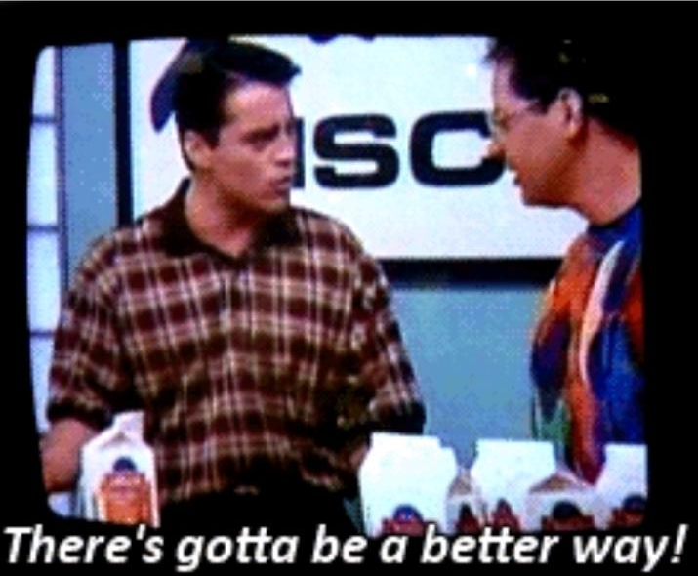
Reduce – The Imperative Way
const numbers = [1, 2, 3, 5, 8]
let total = 0
for (const num of numbers) {
total += num
}
console.log(`Sum is ${total}`)
// Output is: Sum is 19

Slide 23
Reduce
Reduce Function
Operate on the elements in a collection and “reduce” them to a single value
const numbers = [1, 2, 3, 5, 8]
const total = numbers.reduce((accumulator, num) => accumulator += num)
console.log(`Sum is ${total}`)
// Output is: Sum is 19

Slide 24



Filter
Get the elements from a collection matching some criteria

Slide 25
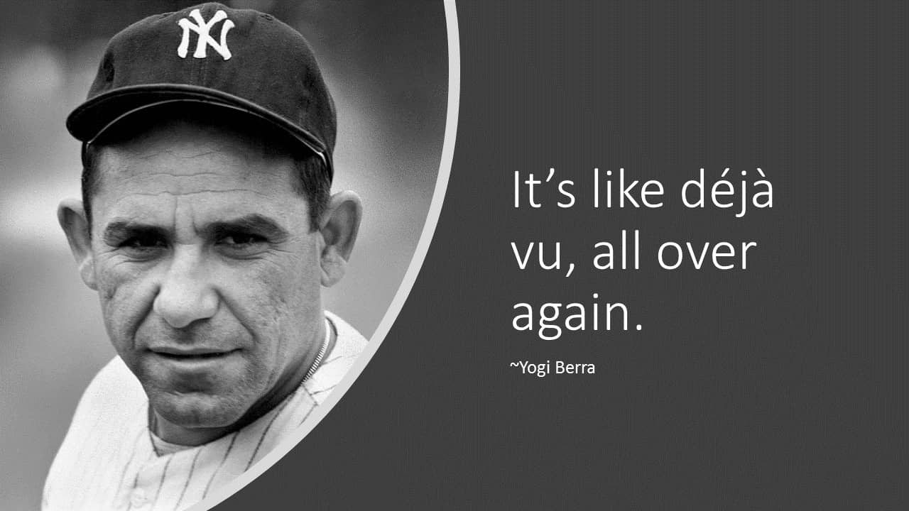
Filter – The Imperative Way
const fruits = [
{ name: "lime", color: "green" },
{ name: "banana", color: "yellow" },
{ name: "apple", color: "red" },
{ name: "lemon", color: "yellow" }
]
const yellowFruits = []
for (const fruit of fruits) {
if (fruit.color === "yellow") {
yellowFruits.push(fruit)
}
}
console.log(yellowFruits)
// Output is: [ { name: "banana", color: "yellow" },
// { name: "lemon", color: "yellow" } ]

Slide 26
Filter
Filter Function
Get all the elements from a collection matching some criteria
const fruits = [
{ name: "lime", color: "green" },
{ name: "banana", color: "yellow" },
{ name: "apple", color: "red" },
{ name: "lemon", color: "yellow" }
]
const yellowFruits = fruits.filter(fruit => fruit.color === "yellow")
console.log(yellowFruits)
// Output is: [ { name: "banana", color: "yellow" },
// { name: "lemon", color: "yellow" } ]

Slide 27
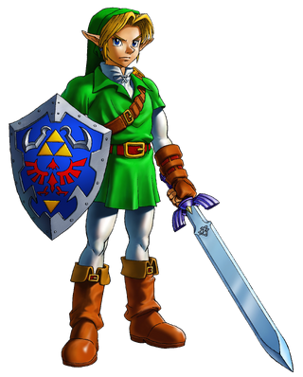
LINQ
Language Integrated Query
A domain-specific query language, built-in to .Net
Often used in relation to database queries, but can be used on any supported data

Slide 28
LINQ Example
using System;
using System.Collections;
using System.Linq;
// Define an array of scores
int[] scores = { 97, 92, 81, 60 };
// Define a query to find all scores > 80
IEnumerable scoreQuery =
from score in scores
where score > 80
select score;
// Execute the query
foreach (int i in scoreQuery)
{
Console.Write(i + " ");
} // Output is: 97 92 81

Slide 29

Java Streams
A pipeline to produce a sequence of objects
Created from a Collection
Introduced in Java 8
No coincidence that Lambda Expressions were also introduced in Java 8

Slide 30
Java Stream Example
List<String> words = List.of("CODE", "CRAFT", "COMMUNITY", "PIZZA", "BEER");
// Create the stream
String c3WordsLower = words.stream()
// Map (convert) the words to lowercase
.map(word -> word.toLowerCase())
// Filter to only get the C3 words
.filter(word -> word.startsWith("c"))
// Reduce (combine) the C3 words into a single string
.reduce("", (accumulator, word) -> accumulator + word + " ");
System.out.println(c3WordsLower);
// Output is: code craft community

Slide 31
Wifi Password: ComeJoinUs2!
https://github.com/Ingage-Meetup/20230920-map-reduce

Slide 32

Handy QR Codes

Slide 33
Raffle
A Jetbrains license, good for any of their IDEs (IntelliJ, WebStorm, etc.) for one year. It is a “perpetual fallback license”, meaning you can continue to use the version of the IDE that was activated, even after the year has passed and the license is expired.
Winners, talk to Jim Kriz, who will send you a PDF with details to redeem your license.
Notes:
Suppose you're on a game show, and you're given the choice of three doors: Behind one door is a car; behind the others, goats. You pick a door, say No. 1, and the host, who knows what's behind the doors, opens another door, say No. 3, which has a goat. He then says to you, "Do you want to pick door No. 2?" Is it to your advantage to switch your choice?

Slide 34
As developers we are:
…deliberately trying to get better
…not focused on any particular stack, vendor, or language
…better as a group
…here to write code, think about code, discuss the craft
…dreaming of eating pizza together

